Slide 1
Experience
on
Reasoning Model

Slide 2
Reasoning language models are just language models with reasoning ability

Slide 3
Training Process
Define template to guide model to adherence a specified format
Fine-tuning base model on a high quality reasoning dataset
Apply reinforcement learning training process afterwards
Base model
(SmolLM2)
SFT + RL
Reasoning model
(SmolLM2)
Data

Slide 4
Fine-tuning phase
Collect a collections of long chain of thought data
Use LORA or full fine-tuning depending on your compute resources
Training frameworks: torchtune, hugging face, unsloth…
Some key takeaways:
Quality of data plays an vital role, almost the time is in this process
Prefer full fine-tuning instead of Lora for better performance
Use Hugging Face and Unsloth for fast experiments on new features, and Torchtune for stability and customization

Slide 5
Reinforcement learning phase

Slide 6
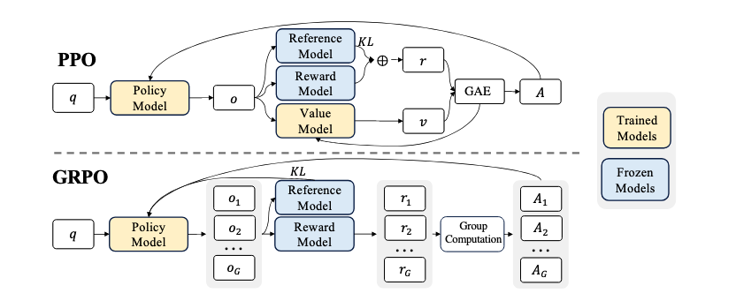
Group Relative Policy Optimization (GRPO) is a reinforcement learning algorithm designed to train large language models (LLMs) for complex tasks like solving math problems or writing code.

Slide 7
How GRPO works
The model generates multiple possible answers for each question
A reward model scores each answer (e.g., giving higher scores for correct math answers)
The average score of all answers for that question is calculated
Each answer’s score is compared to this average to determine its "advantage"—how much better or worse it is
The model updates itself to favor answers with higher advantages, making sure the changes are gradual to maintain stability

Slide 8
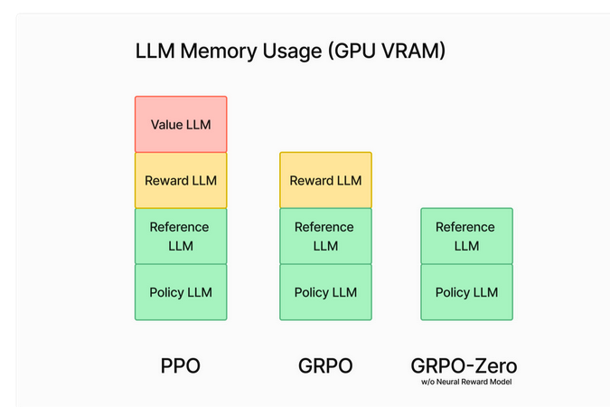

Slide 9
Reward Functions vs Verifiers in Reinforcement Learning

Slide 10
Verifier
Determines whether a response is correct or incorrect
Does not assign a numerical score—it simply verifies correctness
Example: If a model outputs "5" for "2 + 2", the verifier checks and labels it as incorrect (since the correct answer is 4)
Can execute code (e.g., in Python) to validate logic, syntax, and correctness without manual review
Reward Function:
Assigns a numerical score based on correctness or other criteria
Example: A wrong answer might get a penalty (-1, -2, etc.), while a correct one earns a positive score (+1, +2)
Can incorporate additional penalties or rewards for factors like excessive length or poor readability
Key Differences:
A Verifier checks correctness but does not score
A Reward Function assigns a score but doesn’t necessarily verify correctness
A Reward Function can use a Verifier, but they are not the same

Slide 11
Basics & Tips for GRPO Training
Wait for at least 300 steps for the reward to actually increase. In order to get decent results, you may need to trade for a minimum of 12 hours (this is how GRPO works), but keep in mind this isn't compulsory as you can stop at anytime.
For optimal results have at least 500 rows of data. You can try with even 10 rows of data but it's better to have more.
Each training run will always be different depending on your model, data, reward function/verifier etc. so though 300 steps is what we wrote as the minimum, sometimes it might be 1000 steps or more. So, it depends on various factors.
It’s advised to apply GRPO to a model at least 1.5B in parameters to correctly generate thinking tokens as smaller models may not.
Continuous fine-tuning is possible and you can just leave GRPO running in the background.
If you’re using a base model, ensure you have a chat template.
The more you train with GRPO the better. The best part of GRPO is you don't even need that much data. All you need is a great reward function/verifier and the more time spent training, the better your model will get.

Slide 12
Data Curation Criteria

Slide 13
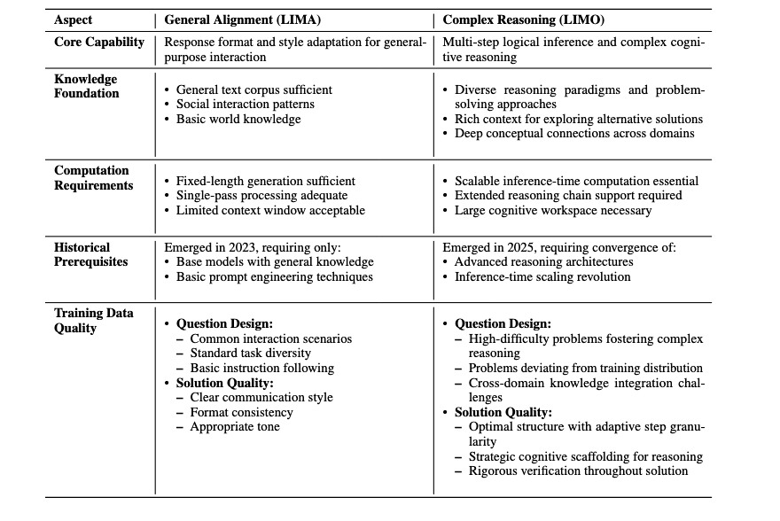

Slide 14
References:
https://docs.unsloth.ai/basics/reasoning-grpo-and-rl#reward-functions-verifier
https://colab.research.google.com/github/unslothai/notebooks/blob/main/nb/HuggingFace%20Course-Gemma3_(1B)-GRPO.ipynb
https://ghost.oxen.ai/why-grpo-is-important-and-how-it-works/

